Slide 1
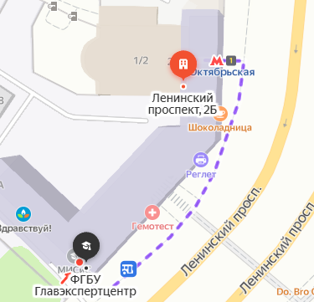
Expertise and Recognition Procedure of Educational Documents :
What you should do?
Do you have with you:
Passport with visa (at least 6 months valid)
Original educational document
Original supplement to the educational document with the list of all study courses and notes
Are all the educational documents stamped by:
The Ministry of Foreign Affairs
The Russian Consulate
Get the appropriate stamps (legalize or apostil) in a country where this document was issued.
Have all 3 documents been translated properly? (stamp from the Ministry of Foreign Affairs must be translated too)
Have all 3 documents been properly notarised?
YES
YES
YES
For Recognition Procedure you are required to pay approximately 6500 rubles per document for processing fees.
Proceed with Recognition Procedure !
The Way from the Metro Station “Oktyabrskaya " (Circle Line)
«Main State Center for Education Evaluation»
is located on the following address:
Leninsky Prospekt, 2A, Moscow, Russia
zip: 119049
Telephone: +7 (495) 317-17-10, +7 (495) 665-00-15
E-mail: secretary.fgbu@glavex.ru
Official website: http:/nic.glavex.ru/
Working hours:
Monday - Thursday:
9:30-17:30 (lunch: 13:00-14:00)
Friday:
9:30-16:15 (lunch: 13:00-14:00)
Metro “Oktyabrskaya”
“Glavekspertcentre”
Leninsky Prospekt, 2A

